Slide 1
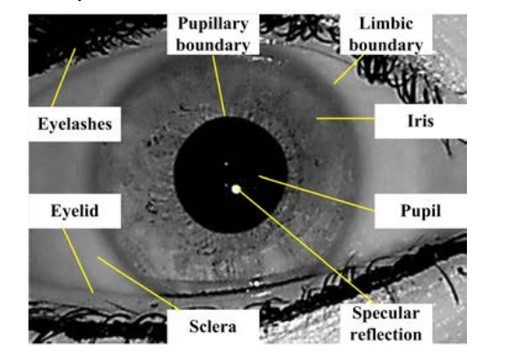
Heart DISEASE DETECTION USING IRIDOLOGY
Supervisor :
Dr. Asma Kanwal
Assistant Professor
Group members:
Azhar Ud Din 0115-BSCS-20
Shajar Abbas 0304-BSCS-20

Slide 2
introduction
1 Overview of Cardiovascular Diseases (CVDs) in Pakistan and globally.
1.1 Cardiovascular Disease (CVD) in Global Health
According to WHO (World Health Organization) report of (June 2011)
Estimated 17.9 million deaths in 2019 due to heart disease and strokes.
32% of all global fatalities in 2019 were attributed to CVDs.
85% of these fatalities were due to heart attacks and strokes.
Over 75% of CVD deaths occur in low and middle-income countries.
Premature deaths (under 70 years) account for 17 million deaths in 2019. 38% of these premature deaths are due to CVD. [1]
Cardiovascular Disease (CVD) refers to a group of disorders affecting the heart and blood vessels, including conditions like heart attacks, strokes, and hypertension.
[1] : WHO. 2021. World Health Organization. June 11. https://www.who.int/news-room/fact-sheets/detail/cardiovascular-diseases-(cvds)?gad_source=1&gclid=CjwKCAjwodC2BhAHEiwAE67hJHb4C-soJoQRQ4Bt1Ng0RmzpsKgQaiKcNisWzjP-FBjKklX5hXWjgxoC1yYQAvD_BwE.

Slide 3
INTRODUCTION
1.2 Cardiovascular Disease (CVD) in Pakistan
According to Samad and Hanif 2023 research report
Age-standardized death rate for CVD in Pakistan: 357.88 per 100,000
(compared to global rate of 239.85).
Projected age-standardized incidence of CVD: 918.18 per 100,000 in Pakistan.
18.9% of people self-report having CVDs in the National Socioeconomic Registry Survey.
Survey data covers 34 million households in Pakistan. [2]
2 Significance of Early Detection
Early detection of CVD is crucial to reducing mortality rates and improving quality of life. However, traditional diagnostic methods are often costly and time-consuming, limiting access, especially in low and middle-income countries where more than 75% of CVD deaths occur (WHO, 2019).
[2]: Samad, Zainab, and & Bashir Hanif. 2023. "Cardiovascular Diseases in Pakistan: Imagining a Post pandemic, Post conflict Future." https://orcid.org/0000-0003-2422-3199 147: 1261-1263. doi: 10.1161/CIRCULATIONAHA.122.059122.

Slide 4
Introduction
3 Introduction to Iridology
Iridology: The study of iridology describes the structure of the human iris as an observation of the condition of organs in the body.[1]
According to the (Bernard Jenssen n.d.) Iris is a Window which shows what does inside the body. The iris reveals the tissue conditions of each organism of the body. When the darkness found in any area of the Iris, it corresponds to pathology somewhere in body. (pg67). That’s why the iridology is the priceless tool to primary health care professionals using wholistic approach. (pg 61).[2]
Pathological conditions can be identified through color changes in the iris.
[1]: P.K, Tadiparthi, and & Bheemavarapu P.K. 2020. "Automated Heart Dysfunctionality Identification Based on Iris using Deep Learning." International Journal of Innovative Technology and Exploring Engineering (IJITEE) 9 (5). doi: 10.35940/ijitee.E2526.039520.
[2]: Bernard Jenssen, D.C, phD. n.d. IRIDOLOGY The Science and Practice in the Healing Arts. Vol. 2. Bernard Jensen, Publisher.

Slide 5
Problem Statement
1 Challenges in Early Detection of CVD
High cost of tests and medical consultations for early detection.
Traditional heart check-ups are expensive and time-consuming.
Lack of affordable and convenient methods for early heart disease detection.
2 Limitations of Traditional Diagnostic Methods Traditional heart checks, like ECGs and physical exams, are often inconvenient and take long time for results. Additionally, they may not detect CVDs at early stages, leading to missed opportunities for preventive care.
3 Need for an Affordable, Non-Invasive Detection Method With the rising number of CVD-related deaths, especially in underserved populations, there is an urgent need for more affordable, rapid, and non-invasive alternatives. Iridology offers a promising solution, as the iris is believed to reveal internal health conditions, including potential heart abnormalities.

Slide 6
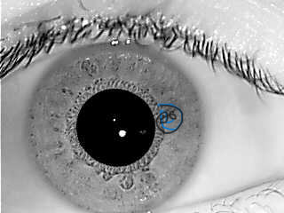
Iridology as a Solution
Iridology: The study of the iris of the eye to diagnose internal health conditions.
Dr. Bernard Jensen claims the iris can reflect the health of internal organs.
Pathological conditions can be identified through color changes in the iris.
Heart Detection using Iridology:
According to Dr. Jensen's chart, the heart is located in the 2:00 to 3:15 o'clock region of the left iris.
Fig 01, 01_L.bmp IIT delhi 0.1 data set iris image, circled the heart segment for visibility and identification

Slide 7
Objectives of the Study
To Develop an Automated System for Heart Disease Detection Using Iris Images This project aims to create an automated system that can classify heart conditions from iris images, providing an efficient and low-cost solution for early CVD detection.
To Utilize Iridology and Machine Learning for Early Classification of Heart Abnormalities The system will combine Iridology and machine learning techniques to classify heart images as either normal or abnormal, helping healthcare providers detect potential heart issues at an early stage.
To Explore the Effectiveness of Feature Reduction and Neural Networks in CVD Detection We will test how Principal Component Analysis (PCA) can reduce the dimensionality of the data, and evaluate the role of Neural Networks (CNN) in improving the accuracy of heart disease classification. But the data set of IIT delhi was unlabelled, so we used clustering for classification.

Slide 8
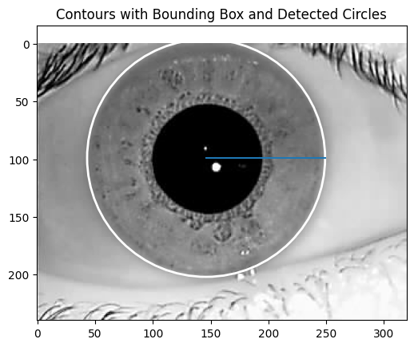
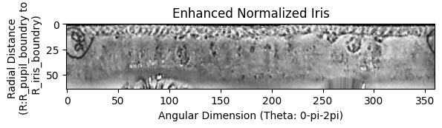
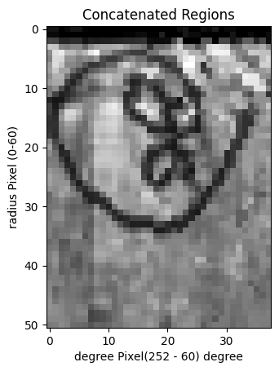
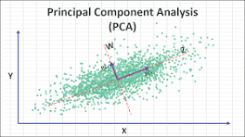
Theoretical Framework for Heart disease detection using iridology
Fig 03: Iris segment Normalization
Fig 02: Image Localization and segmentation
Training a model to classify either Normal or abnormal heart patient
Training model to classify either Normal or abnormal heart patient
Fig 04: Heart segment Feature Extraction from Iris normalized image
Fig 01 : Image preprocessing ITT delhi v1.0; heart segment circled for visibility
Note : 90% problem faced during image processing, 10% model traning
Fig 05: Feature reduction. Example PCA shared by Numxl.com

Slide 9
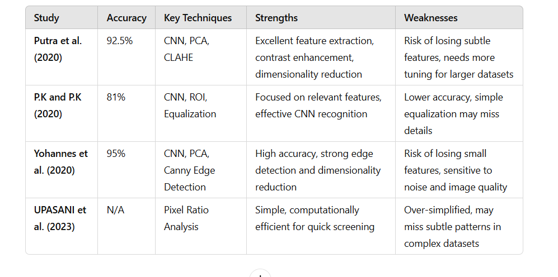
Literature Review
[1]: Pu (Percy & Waqas)tra, L, R Isnanto, A Triwiyatno, and V. and Gunawan. 2020. "Heart Disease Detection using Iridology with Principal Component Analysis (PCA) and Backpropagation Neural Network."
[2]: P.K, Tadiparthi, and & Bheemavarapu P.K. 2020. "Automated Heart Dysfunctionality Identification Based on Iris using Deep Learning." International Journal of Innovative Technology and Exploring Engineering (IJITEE) 9 (5). doi: 10.35940/ijitee.E2526.039520.
[3]: Yohannes1, C., Nurtanio1, I., & Halim1, a. K. (2020). Potential of Heart Disease Detection Based on Iridology. IOP Publishing Ltd, 1-8. doi:10.1088/1757-899X/875/1/012034
[4]: UPASANI, N., MANNA, A., PINGALE, S., SHINDE, Y., RATHI, S., & SURPATNE, &. (2023, Febrary 28). CARDIOVASCULAR ABNORMALITIES DETECTION THROUGH IRIS USING THRESHOLDING ALGORITHM. ww.jatit.org, 101-No.4, 1322-1330.

Slide 10
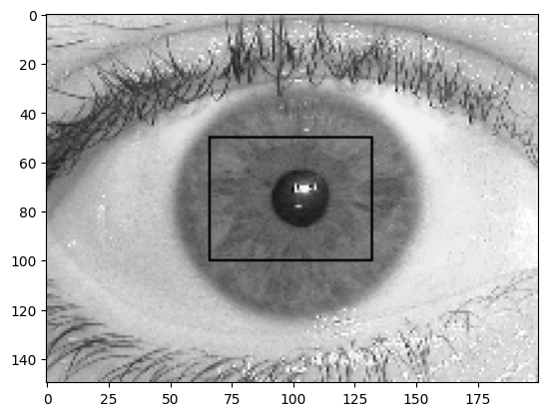
Methodology
0 | 0 | 0
0 | 1 | 0
0 | 0 | 0
1. Image preprocessing [1]
1.1 Grayscale to RGB Conversion
1.2 Equalization of Histograms
1.3 Morphological Operation (MATLAB term for imfill)
1.4 Local Minimum Detection
1.5 Image Cropping and Iris Size Consideration
Fig 4.1: 3x3 neighborhood
Pixels scan
Fig 4.2: Image Cropping and Iris Size Consideration for analysis and checking for iris part.
[1]: Percy, O., & Waqas, &. A. (n.d.). Iris localization using Daugman’s algorithm. Blekinge Institute of Technology.

Slide 11
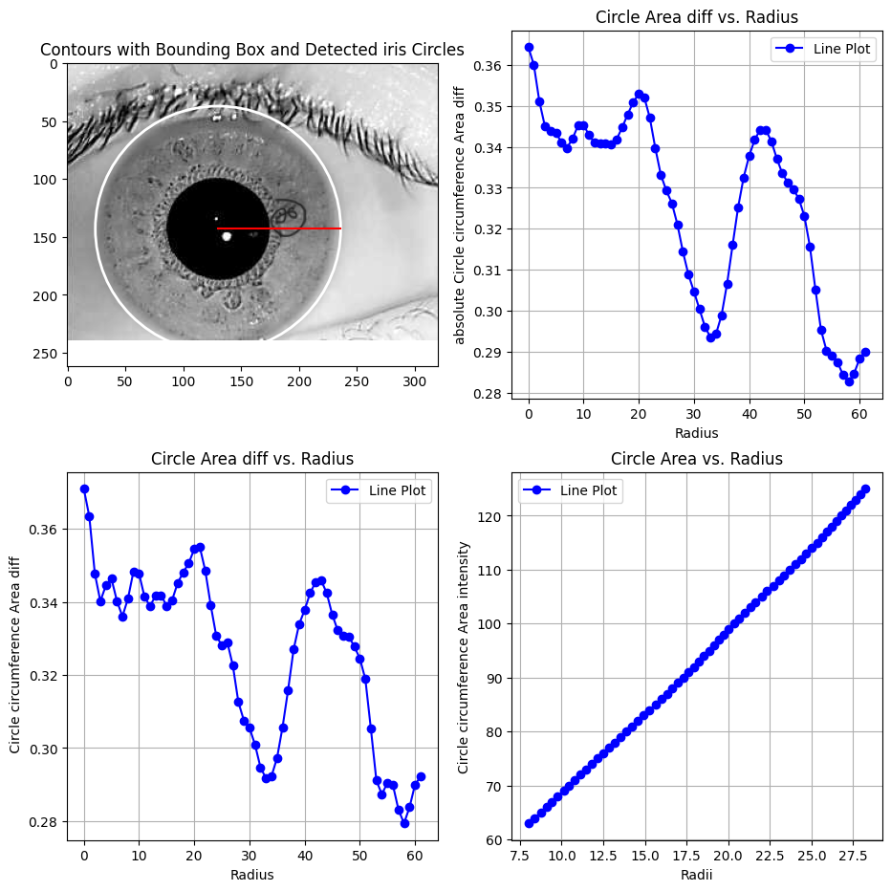
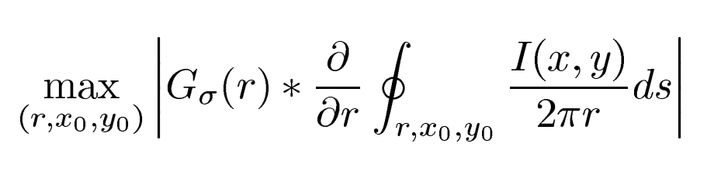
Methodology
Fig 4.4 shows iris part detection by Daugman’s operator algorithm, Fig 4.5 and 4.6 shows the sum of circumference intensities with change of radius, and Fig 4.7 shows change of intensity with increase of radius in iris part of an eye respectively.
Image Localization
Fig 4.3 Daugman’s operator algorithm
Here, r is radius of circle, 2*pi*r is the circumference of circle, and G sigma(r) is the Gaussian filter at sigma variation for noise reduction and smoothing of image. (ds) is change in contour at radius r. I(x,y) is the image intensity of pixel (x,y).[1]
Algorithm working explanation:
With the change of radius r, the contour is changed. And the pixels of contour is summed up. Contour is the circumference of circle with radius r. means, only the circumference pixels at radius are summed up from center at pixel (Xo,Yo). Which the sum result is normalized by 2*pi*r.
After finding the summed normalized area of each contour, the Gaussian filter with sigma=1 is applied. Then, max change between each two consecutive contours is considered as the boundary point of iris circle at radius r from center at pixel (Xo,Yo).
[1]: Percy, O., & Waqas, &. A. (n.d.). Iris localization using Daugman’s algorithm. Blekinge Institute of Technology.

Slide 12
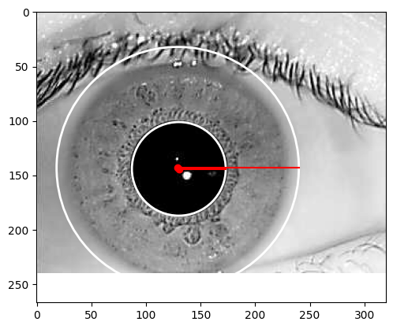
Methodology
3. Iris Segmentation
In Iris segmented from the image between the iris boundary, called lambic boundary separating sclera from iris part, and pupil boundary, which is 0.2 to 0.5 times the radius of iris boundary radius.[8][4]
Circle Center pupil: (130, 144), Radius: 43
Best circle found at (x, y) = (129, 143) with radius r = 111
Circle Center: (129, 143), Radius: 111
Fig 1 : 10_L.bmp', 001 folder image IIT delhi v.10 shows the iris detection and segmentation by center point and radius r.
[4]: Pu (Percy & Waqas)tra, L, R Isnanto, A Triwiyatno, and V. and Gunawan. 2020. "Heart Disease Detection using Iridology with Principal Component Analysis (PCA) and Backpropagation Neural Network." SCITEPRESS – Science and Technology Publications, Lda 257-264. doi:10.5220/0009009402570264.
[1]: Percy, O., & Waqas, &. A. (n.d.). Iris localization using Daugman’s algorithm. Blekinge Institute of Technology.

Slide 13
Methodology
4. Iris Normalization
Daugman’s rubber sheet algorithm is used for the conversion of iris circular part into rectangle. In rectangle iris the horizontal lines represents radial distance and vertical columns represents the angular dimension theta. The normalized image enhanced using CLAHE (Contrast Limited Adaptive Histogram Equalization) to improve image quality by increasing the intensity of pixel so that a lot of detail can be seen on image. [1] [2][3]
Fig 1: shows circular iris segment conversion into rectangular form.
[1]: P.K, Tadiparthi, and & Bheemavarapu P.K. 2020. "Automated Heart Dysfunctionality Identification Based on Iris using Deep Learning." International Journal of Innovative Technology and Exploring Engineering (IJITEE) 9 (5). doi: 10.35940/ijitee.E2526.039520.
[2]: Pu (Percy & Waqas)tra, L, R Isnanto, A Triwiyatno, and V. and Gunawan. 2020. "Heart Disease Detection using Iridology with Principal Component Analysis (PCA) and Backpropagation Neural Network." SCITEPRESS – Science and Technology Publications, Lda 257-264. doi:10.5220/0009009402570264.
[3]: Yohannes1, C., Nurtanio1, I., & Halim1, a. K. (2020). Potential of Heart Disease Detection Based on Iridology. IOP Publishing Ltd, 1-8. doi:10.1088/1757-899X/875/1/012034

Slide 14
Methodology
5. Feature Extraction
The heart region in Iris is 2:00 to 3:15 o’clock in clock wise direction. Which is our Region Of Interest (ROI). From normalized image the ROI is extracted and used only for further processing.[1][2][3]
Fig 1: shows circular iris segment conversion into rectangular form.
Fig 2: shows heart region feature extraction from normalized iris image
[1]: P.K, Tadiparthi, and & Bheemavarapu P.K. 2020. "Automated Heart Dysfunctionality Identification Based on Iris using Deep Learning." International Journal of Innovative Technology and Exploring Engineering (IJITEE) 9 (5). doi: 10.35940/ijitee.E2526.039520.
[2]: Pu (Percy & Waqas)tra, L, R Isnanto, A Triwiyatno, and V. and Gunawan. 2020. "Heart Disease Detection using Iridology with Principal Component Analysis (PCA) and Backpropagation Neural Network." SCITEPRESS – Science and Technology Publications, Lda 257-264. doi:10.5220/0009009402570264.
[3]: Yohannes1, C., Nurtanio1, I., & Halim1, a. K. (2020). Potential of Heart Disease Detection Based on Iridology. IOP Publishing Ltd, 1-8. doi:10.1088/1757-899X/875/1/012034

Slide 15
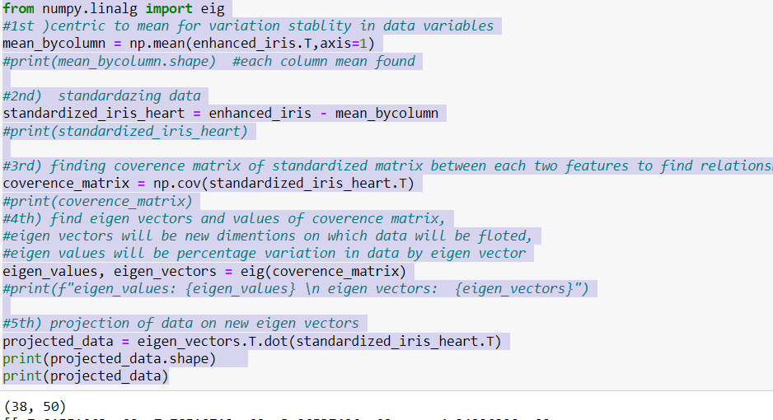
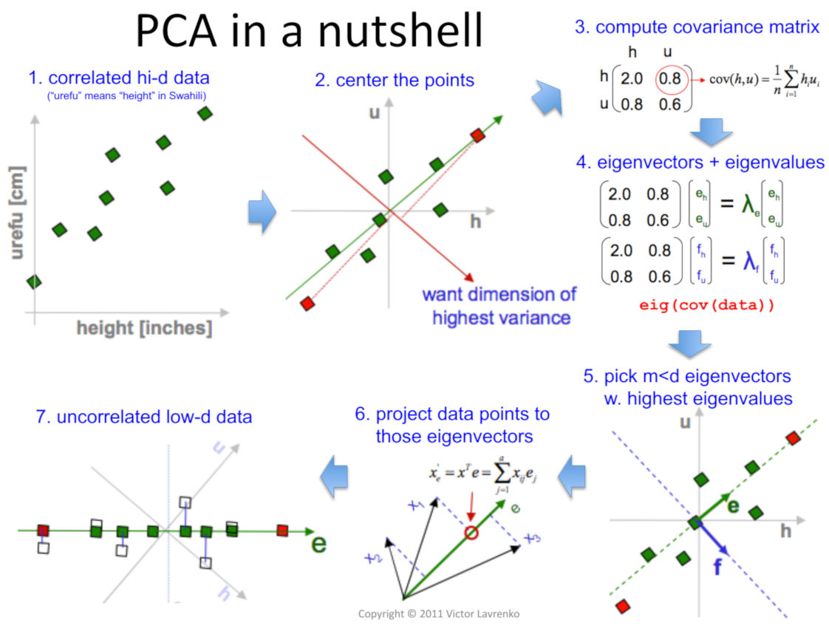
Methodology
6. Feature Reduction
PCA (Principal Component Analysis is used to reduce the features of ROI image. The working of PCA on ROI image is showed below:
The data of ROI image is projected on new eigen vectors having sum of eigen values or variation greater than (90%) ninety percent.
Fig 2 : https://www.analyticsvidhya.com

Slide 16
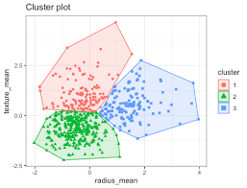
Methodology
7. Classification of Heart Disease Patients
Objective: Classify heart disease patients into two groups: Normal and Abnormal.
Dataset: IIT Delhi v1.0 – Medical images of the heart.
Approach:
Unsupervised Clustering: No labeled data used.
Feature Reduction: Preprocessing to reduce dimensionality and retain key image features. Fig : clusters of three pca components
Clustering Method:
K-Means Algorithm: Groups images into two clusters based on intrinsic similarities.
Normal vs. Abnormal heart conditions identified from clustering.
Outcome:
Successfully automated heart disease categorization.
Potential for faster diagnoses in real-world clinical applications, especially in situations where labeled data is limited or costly.

Slide 17
Results - Automated Classification of Heart Disease Using Iris Images
Objective: Develop an automated system to distinguish between normal and abnormal cardiac conditions using iris images.
Key Techniques:
Preprocessing:
Grayscale conversion, histogram equalization, morphological operations, and local minimum detection optimized for better segmentation.
Cropping focused on the central third of the iris to improve processing speed and accuracy.
Localization & Segmentation:
Daugman’s algorithm used for precise identification of the iris boundary, isolating it from the sclera and other regions.
The system segmented the iris, isolating the region of interest (ROI) relevant to heart disease (2:00 to 3:15 o’clock).
Normalization & Feature Extraction:
Iris normalized using Daugman’s rubber sheet algorithm.
Contrast Limited Adaptive Histogram Equalization (CLAHE) applied for better visibility of details.
Feature Reduction & Classification:
PCA-Based Dimensionality Reduction:
Reduced feature space to retain 90% of the variance, ensuring the model focuses on essential patterns.
Clustering with K-Means:
K-Means clustering used for unsupervised classification of patients into normal and abnormal groups.

Slide 18
Discussion & Impact of PCA on Model Performance
Model Success:
Unsupervised Approach:
The system’s ability to classify heart disease without labeled data proves its robustness and applicability in real-world healthcare scenarios.
PCA’s Role in Feature Reduction:
Increased PCA Components:
Accuracy improved from 68% to 80% when the number of PCA components was increased from 10 to 30, showing enhanced model capacity to detect subtle anomalies.
Decreased PCA Components:
Reducing the number of components caused a loss of crucial features, negatively impacting accuracy.
Model Performance:
The system’s performance highlights the trade-off between reducing dimensionality for computational efficiency and maintaining sufficient variance for accurate classification.
Conclusion:
Optimal number of PCA components is crucial:
More components improve accuracy but increase computational load.
Balancing sufficient feature representation and computational efficiency is key for effective clustering.

Slide 19
Conclusion
This study aimed to develop an automated system for detecting heart disease using iris scans, incorporating Principal Component Analysis (PCA), Daugman's iris segmentation algorithm, and K-Means clustering for classification. While the system achieved an accuracy of approximately 80% or less, several critical challenges emerged:
Lack of Generalizable Features: The absence of clear, generalizable features linking iris patterns directly to heart disease limited the system’s ability to consistently classify patients, especially when distinguishing between normal and abnormal conditions.
Iris Segmentation Challenges: The system struggled with iris detection in blurred images, cases where the iris was obscured by eyelashes, or when the iris was less than 50% visible. Daugman's algorithm, although widely used, could not reliably handle such variations, leading to incorrect segmentation and feature extraction.
Unlabeled Dataset: The use of an unlabeled dataset (IIT Delhi 1.0) further complicated the model's training, as it lacked the explicit class distinctions needed for effective supervised learning. This made it difficult to fine-tune the system’s accuracy and performance.
While the study demonstrated the potential for iris-based heart disease detection, these limitations highlight the need for significant improvements in the segmentation algorithm, feature extraction methods, and dataset quality.

Slide 20
Future Work
To overcome the current challenges and improve the system’s performance, future work will focus on the following areas:
Improved Segmentation Algorithms: Develop advanced segmentation techniques capable of accurately identifying the iris in cases of blurring, partial visibility (less than 50%), or interference from eyelashes. These improvements will be crucial for consistent and reliable feature extraction.
Feature Identification and Labeling: Conduct further research to identify consistent and reliable features in the iris associated with heart disease. Additionally, using a labeled dataset with clear distinctions between healthy and diseased cases will enable more effective training of the classification model.
Enhancing Classification Accuracy: Explore supervised learning techniques and optimize the classification model. With labeled data and better feature extraction, the system’s accuracy can be significantly improved beyond the current 80% threshold.
Robust Dataset Expansion: Use diverse, labeled datasets to improve generalization and ensure the system performs well across a variety of populations and iris variations.
These advancements have the potential to transform the system into a more accurate, reliable, and non-invasive tool for heart disease detection, especially in regions with limited access to traditional diagnostic methods.

Slide 21
Web Application
Heart Disease Detection Using Iridology

Slide 22
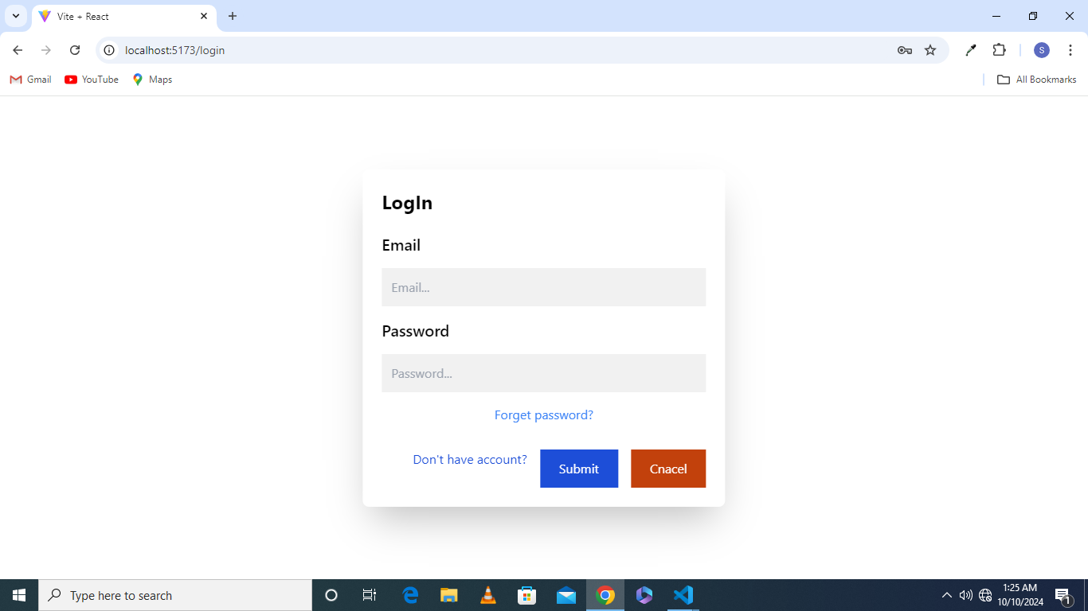
Login page
Implementation and Evaluation
First of all there will be a login page to login user
If the user has forgot the password he will click on the forgot password link and update his password
If the user has no account he will click on a create account link to create a account

Slide 23

Forgot password page
User will provide his e mail address to reset password
Reset token will be sent on his e mail address so he can reset his password
On clicking a reset password on the e mail link and there will be a pop up page which asked the user to provide a new password

Slide 24
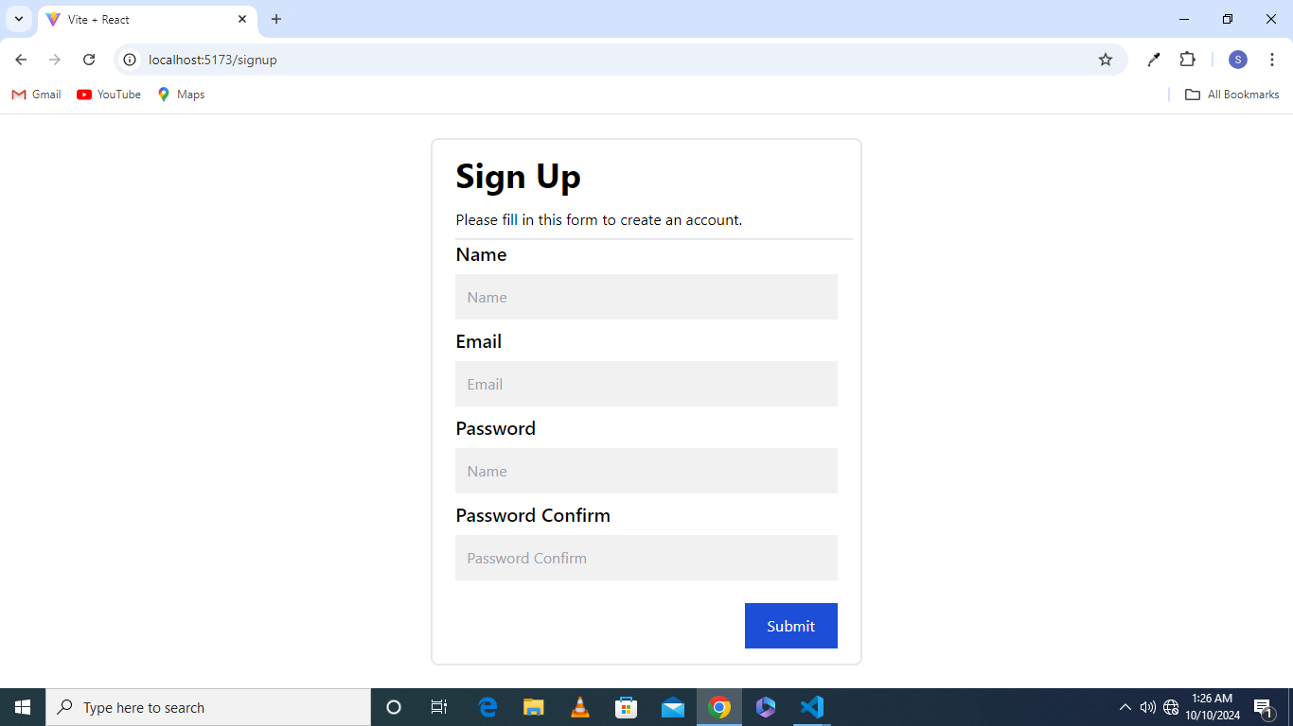
Sign up page
To create a new account the user will provide the following things
Name
E mail
Password
Confirm password
The e mail should be unique and the password must be at least 8 characters

Slide 25
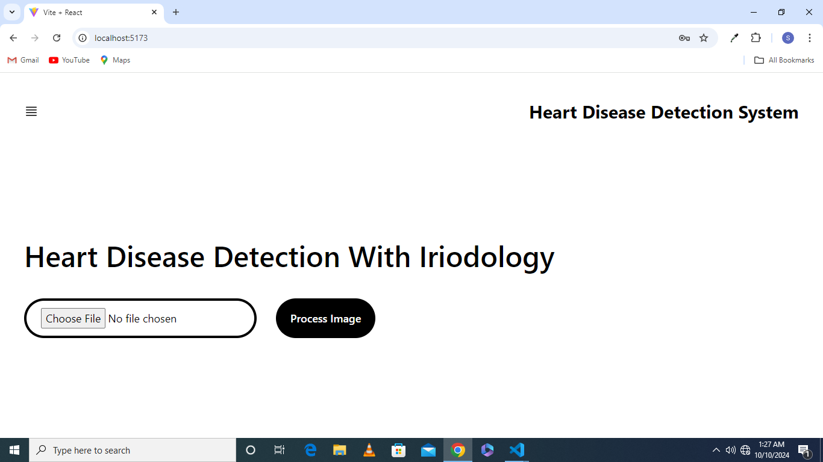
Main page
There will be a button to select an image from storage to process
After that user will click on a process image button
If the user has paid for the service the image will be processed and the result will be shown otherwise the user will be asked to pay for the service
If the user successfully get pay then he will continue the processing

Slide 26
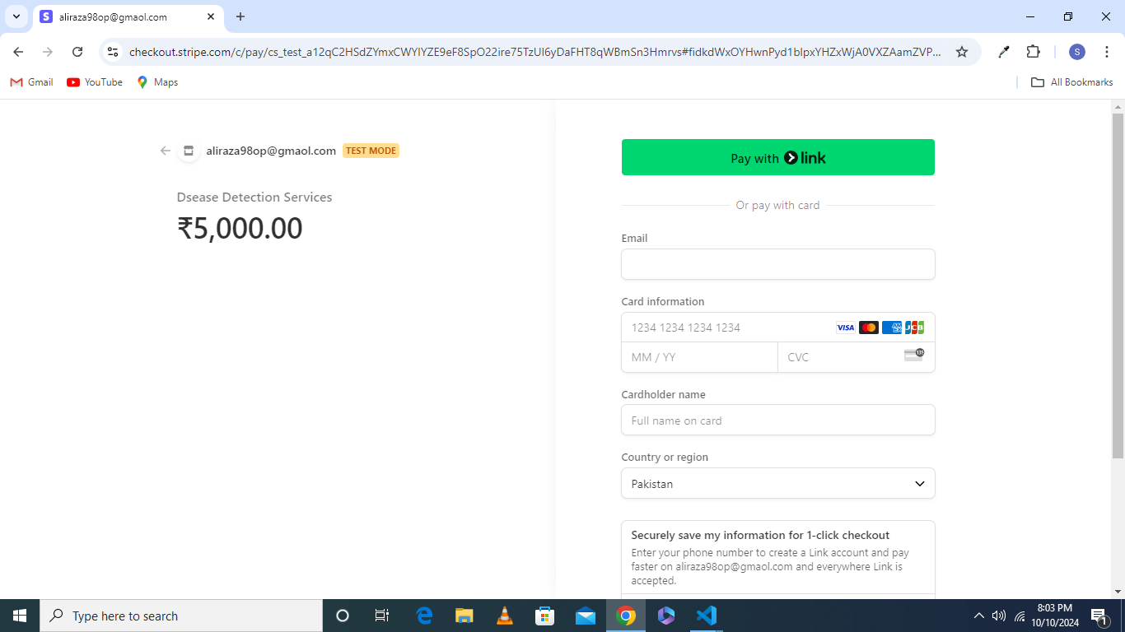
STRIPE PAYMENT PRCESSING
User will click on start pay button and it will be re directed to stripe checkout page
User will be asked to provide his credit card number and its expiry data
On successful detection of charges the user will be directed to success page of our website and it can start processing

Slide 27
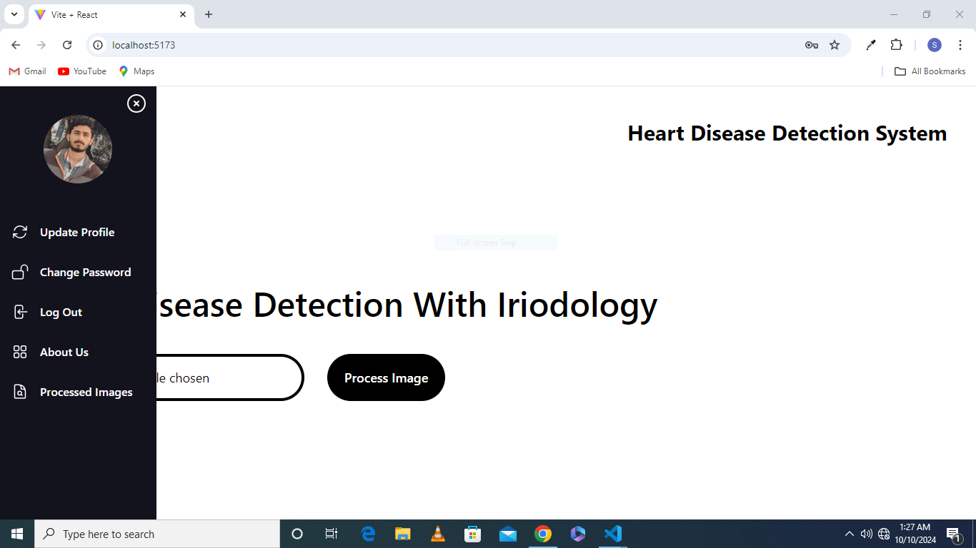
Navbar user actions
User navbar contains the following links
Update profile; user will click on this link to update his profile
Change password; the user will click on the change password link to change the password
Logout; to logout the account the user will click on the logout link

Slide 28
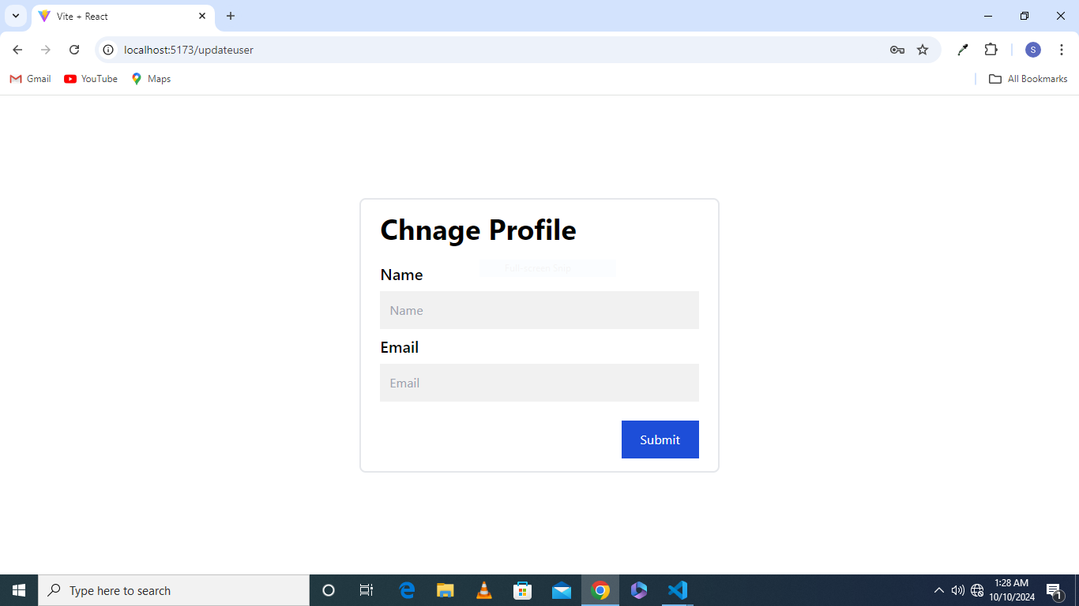
Update profile
User can update his profile information by providing following things
Name
E mail

Slide 29
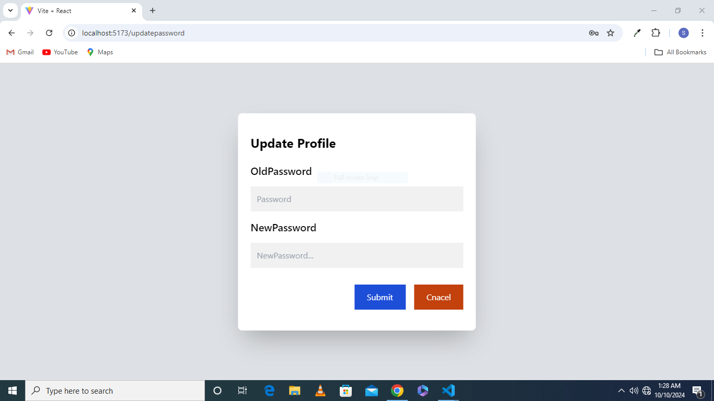
Change password
The user can also change his password by providing previous password and new password values
The user password will be get changed .
But the user should be logged in before changing password otherwise error will be thrown

Slide 30
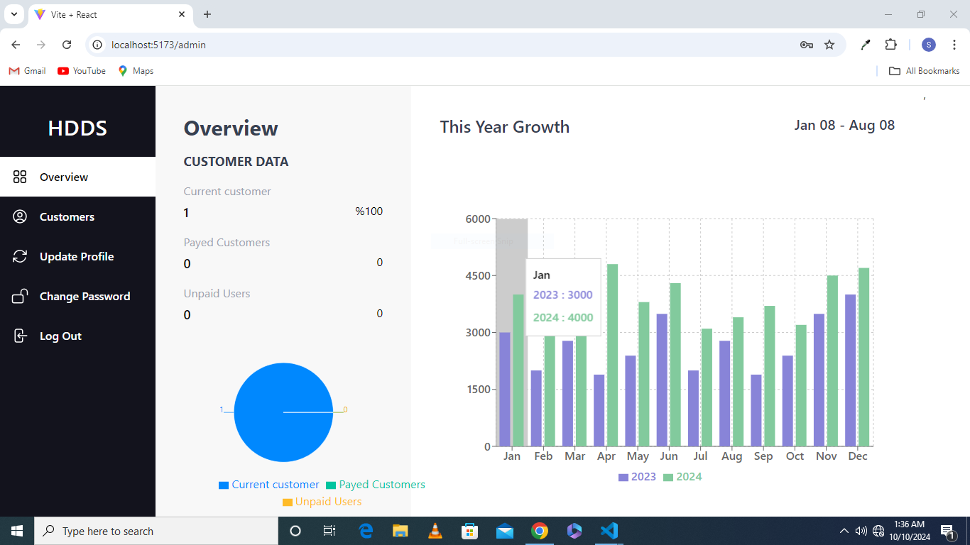
Overview page
Overview page is for admin so that he can get overview the current users information
First there will be information of paid users and also unpaid users and the number of users
Second there will be yearly growth bar graph to show yearly growth of the services

Slide 31
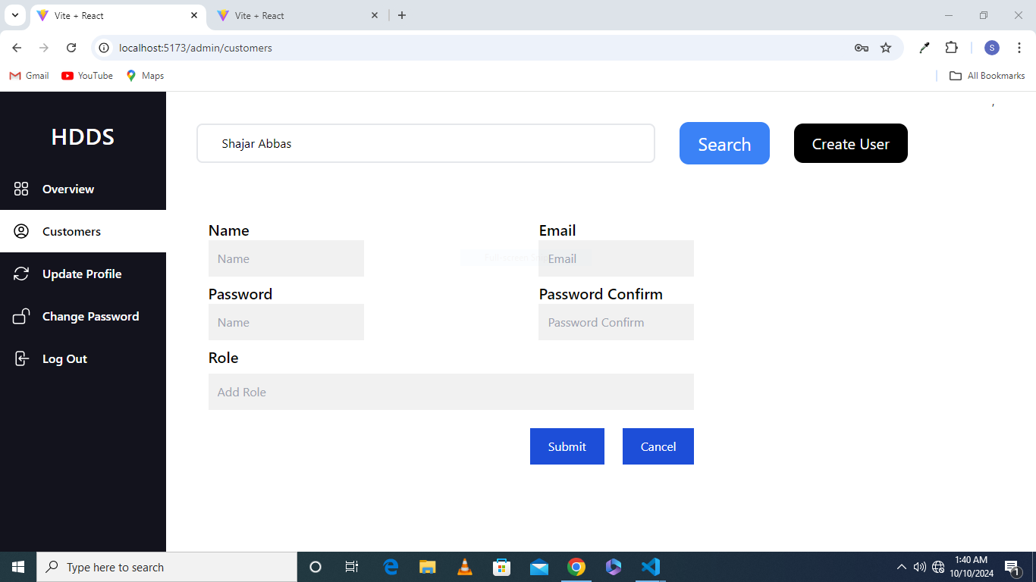
Create user by admin
This page will allow admin to search, create and delete users
Admin will be able to search users by their names and then users will appear and there will be two links and admin can click on these links to update and delete user
There will also be create user button an on licking this button there will be form t create a user and admin can also set the roles of created user

Slide 32
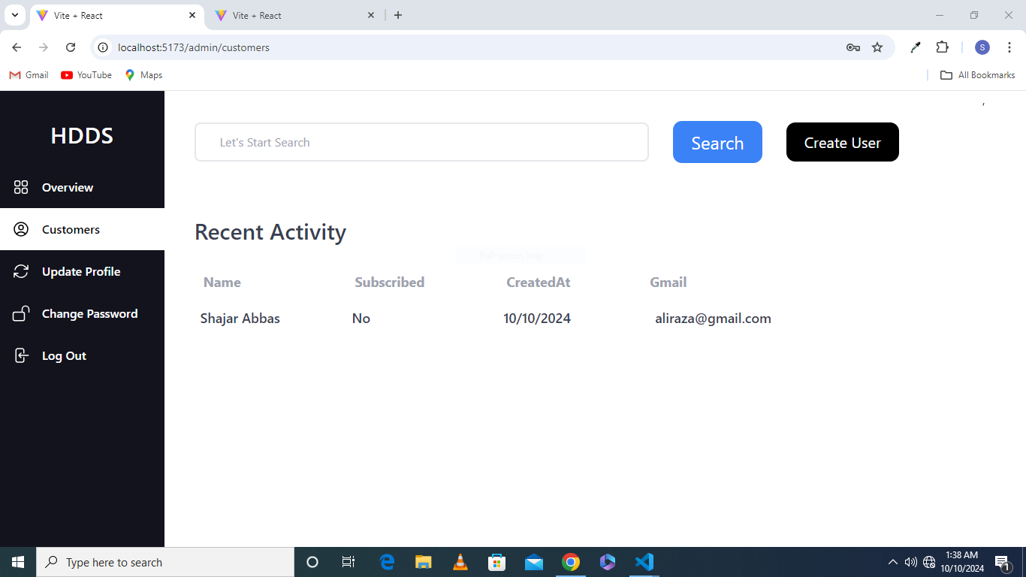
Recent logged in and create and search user facility
By default there will be display of resent account created of users information which include
User name
Email address
Account creating data and time

